Slide 2
Model-Based Design with Simulink
Modeling is a way to create a virtual representation of a real-world system. You can simulate this virtual representation under a wide range of conditions to see how it behaves.
Modeling and simulation are valuable for testing conditions that are difficult to reproduce with hardware prototypes alone.
This is especially true in the early phase of the design process when hardware is not yet available. Iterating between modeling and simulation can improve the quality of the system design early, by reducing the number of errors found later in the design process.

Slide 3
Model-Based Design with Simulink
In Model-Based Design, a system model is at the center of the workflow. Model-Based Design enables fast and cost-effective development of dynamic systems, including control systems, signal processing systems, and communications systems.
Model-Based Design allows you to:
Use a common design environment across project teams
Link designs directly to requirements
Identify and correct errors continuously by integrating testing with design
Refine algorithms through multidomain simulation
Automatically generate embedded software code and documentation
Develop and reuse test suites

Slide 4
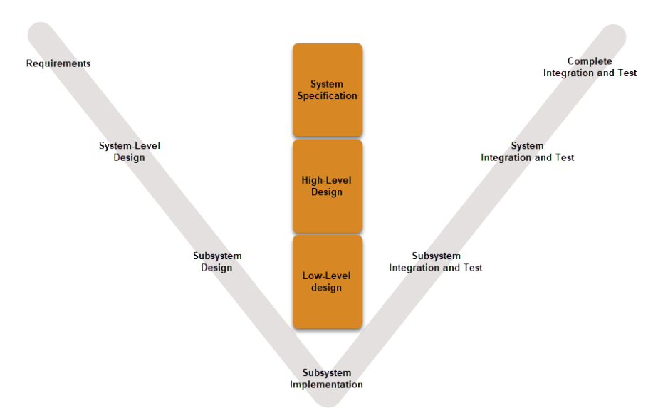
Model-Based Design with Simulink

Slide 5
System definition
The top-level system layout of a Simulink model is a common context that many engineering teams can use and is the basis for many tasks in the Model-Based Design paradigm: analysis, design, test, and implementation.
You define a system at the top level by identifying the structure and individual components. You then organize your model in a hierarchical manner that corresponds to the components. Then you define interfaces for each component and the connections between components.
The featured model in this tutorial is a flat robot that can move or rotate with the help of two wheels, similar to a home vacuuming robot. This model assumes that the robot moves in one of two ways:
Linear — Both wheels turn in the same direction with the same speed and the robot moves linearly.
Rotational — The wheels turn in opposite directions with the same speed and the robot rotates in place.

Slide 6
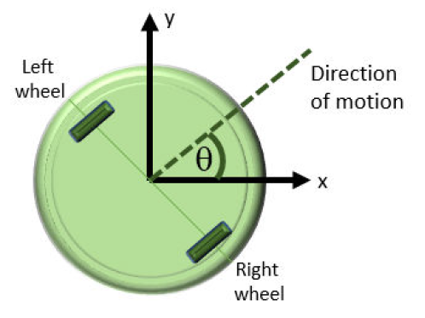
System definition

Slide 7
Determining model objectives
Before designing a model, consider your goals and requirements. The goals dictate both the structure and the level of detail for the model. If the goal is simply to figure out how fast the robot can go, modeling just for linear motion is sufficient.
If the goal is to design a set of inputs for the device to follow a given path, then the rotational component is involved.
If obstacle avoidance is a goal, then the system needs a sensor. Here we build a model with the goal of designing sensor parameters so that the robot stops in time when it detects an obstacle in its path. To achieve this goal, the model must:
Determine how quickly the robot stops when the motors stop
Provide a series of commands for linear and rotational motion so that the robot can move in a two-dimensional space
The first modeling objective enables you to analyze the motion so you can design the sensor. The second objective enables you to test your design.

Slide 8
Identify System Components and Interfaces
Once you understand your modeling requirements, you can begin to identify the components of the system. Identifying individual components and their relationships within a top-level structure help build a potentially complex model systematically. You perform these steps outside Simulink before you begin building your model.
This task involves answering these questions:
What are the structural and functional components of the system?
What are the inputs and outputs for each component? Draw a picture showing the connections between components.
What level of detail is necessary? Include major system parameters in your diagram.

Slide 9
Identify System Components and Interfaces
It is often beneficial to consider the following:
What parts of the system need testing?
What is the test data and success criteria?
Which outputs are necessary for analysis and design tasks?

Slide 10
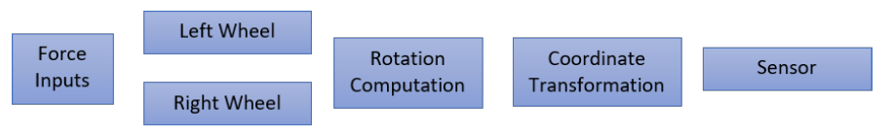
Identify robot motion components
The system in this tutorial defines a robot that moves with two electric wheels in two dimensions. It includes:
Linear motion characteristics
Rotational motion characteristics
Transformations to determine the location of the system in two dimensions
A sensor to measure the distance of the robot from an obstacle

